Slide 1
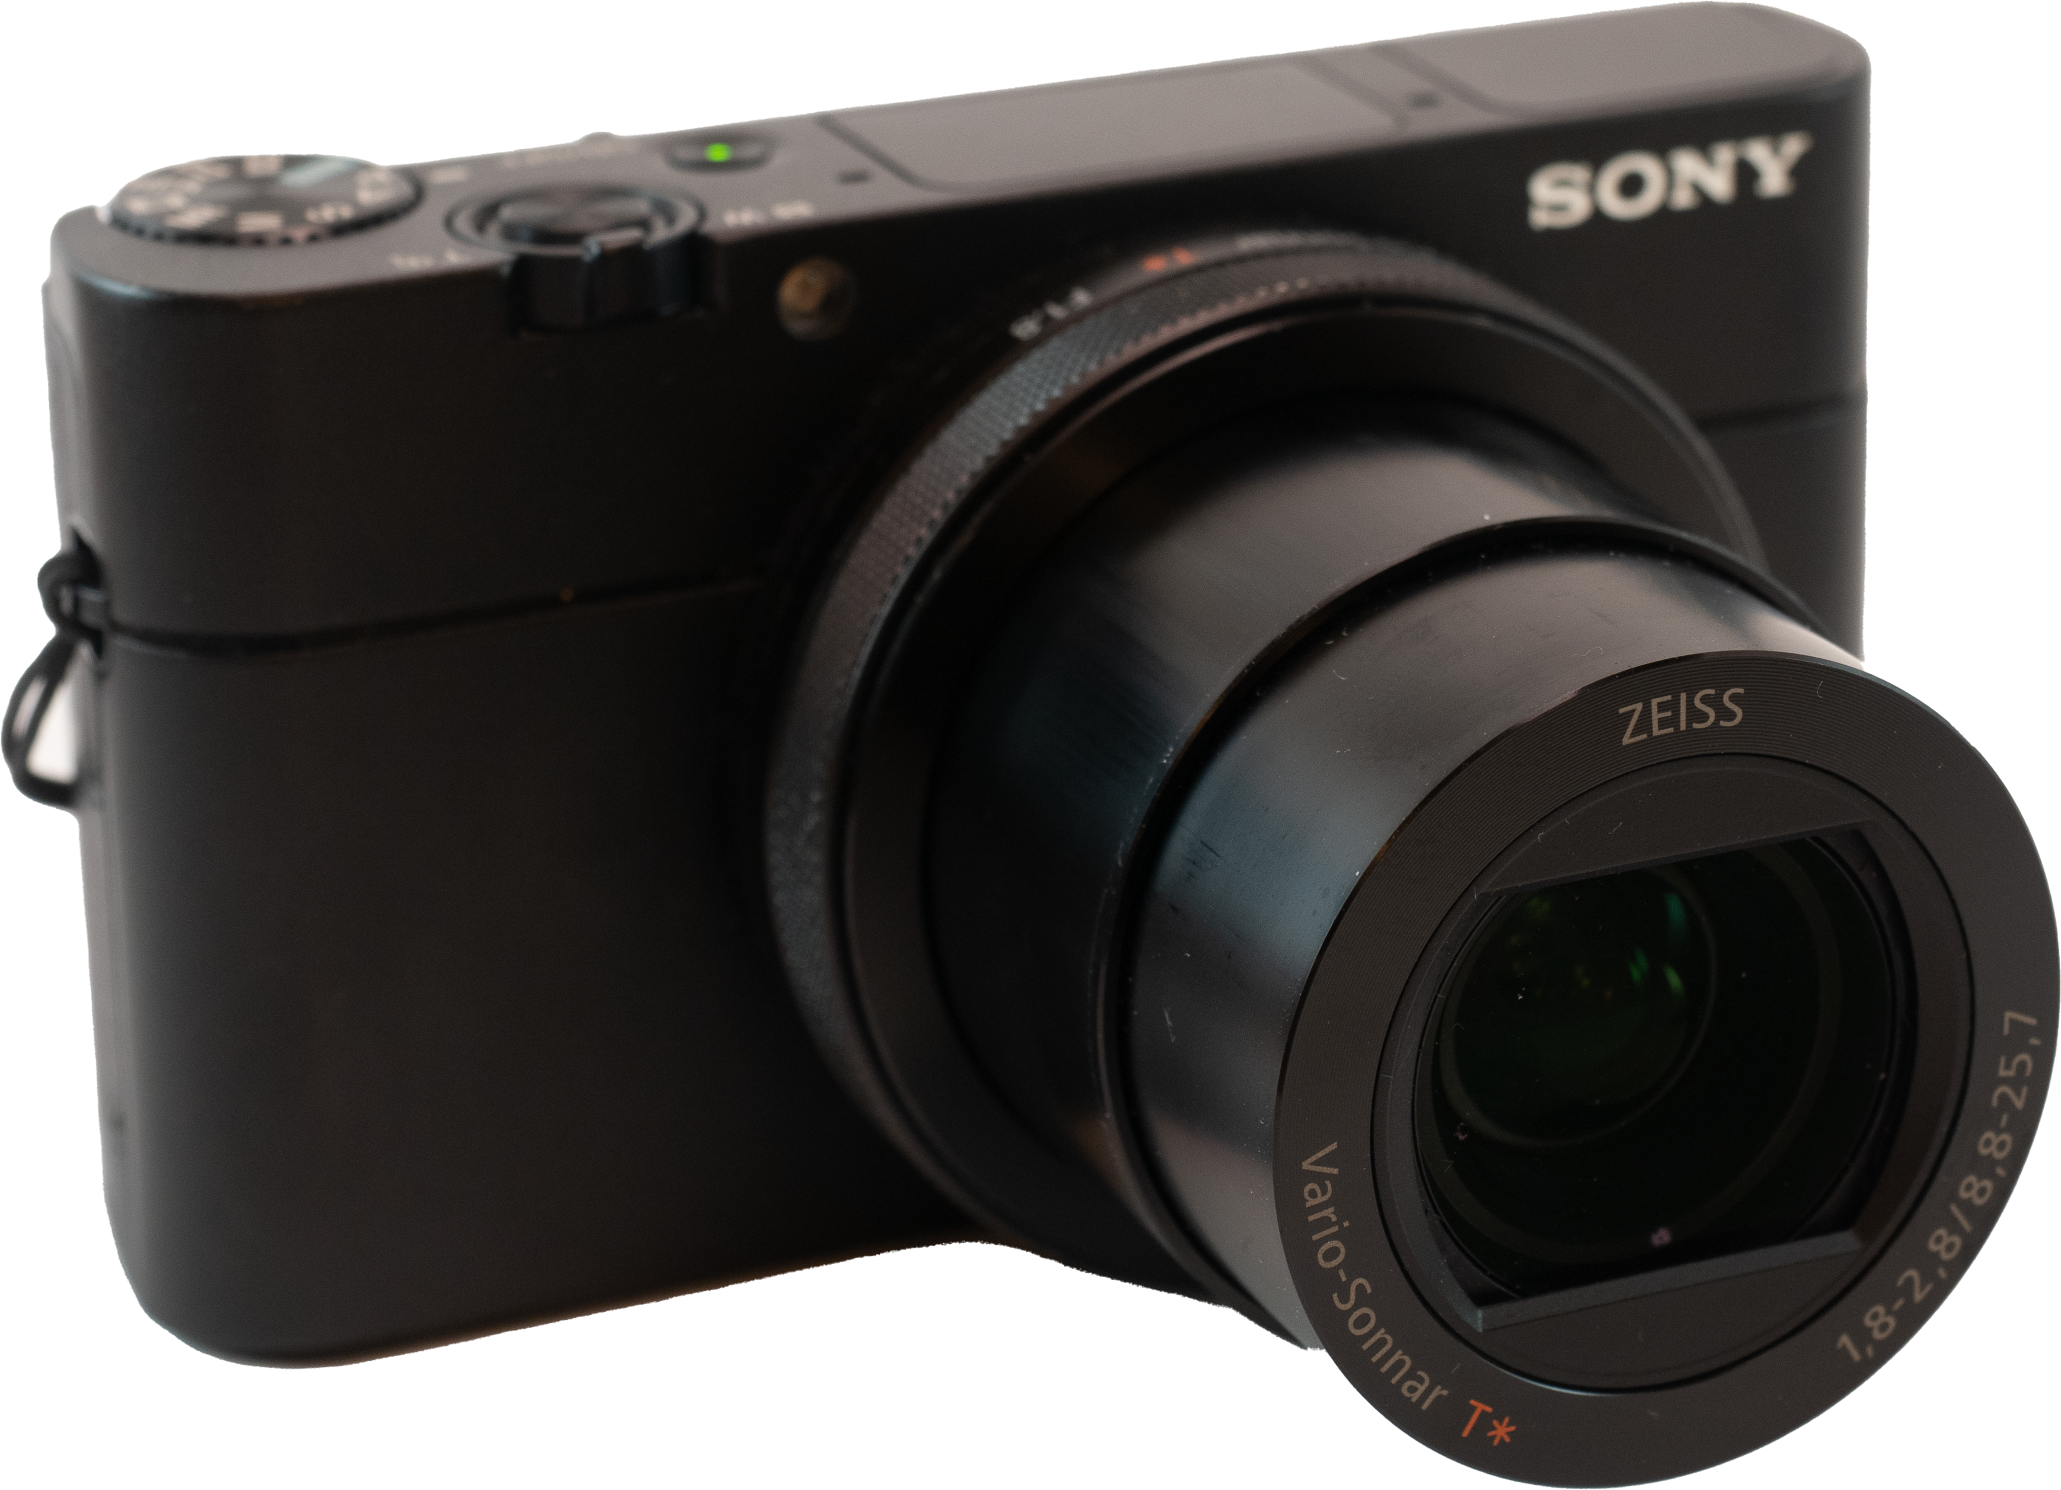
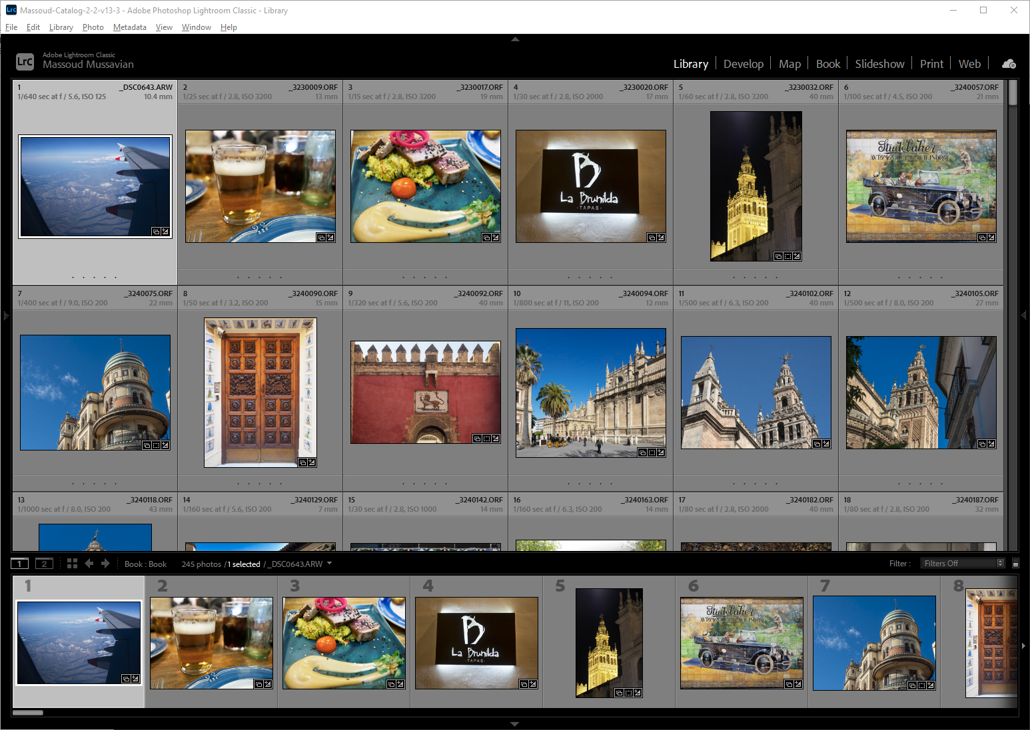
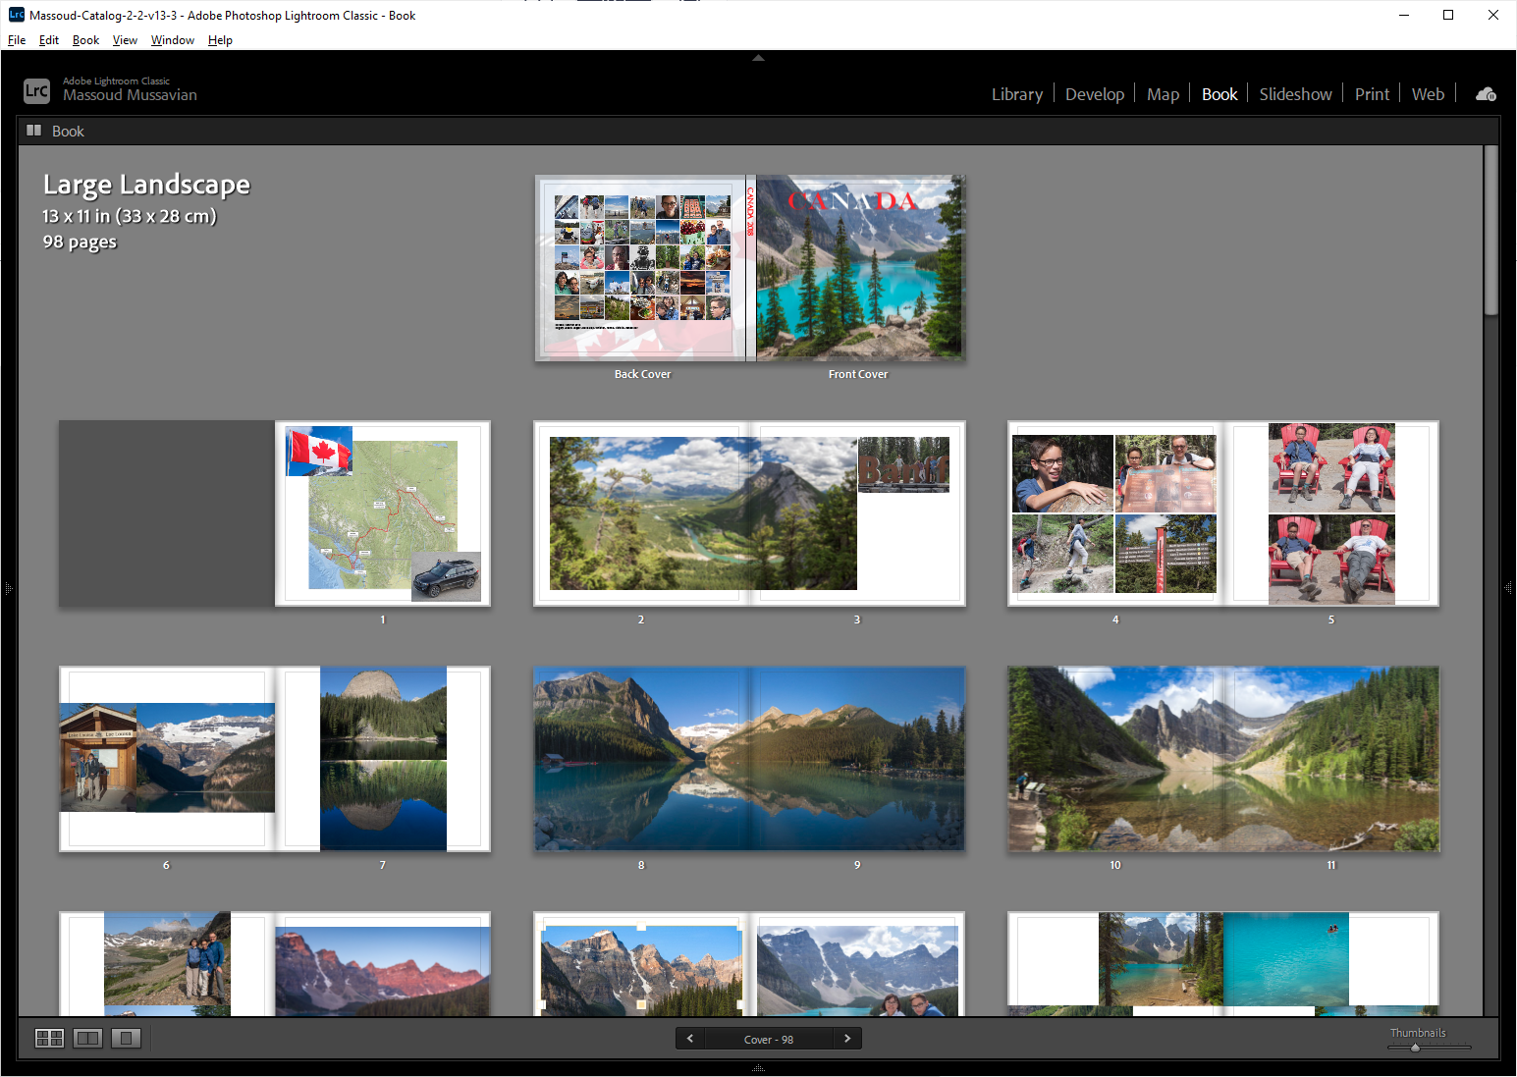
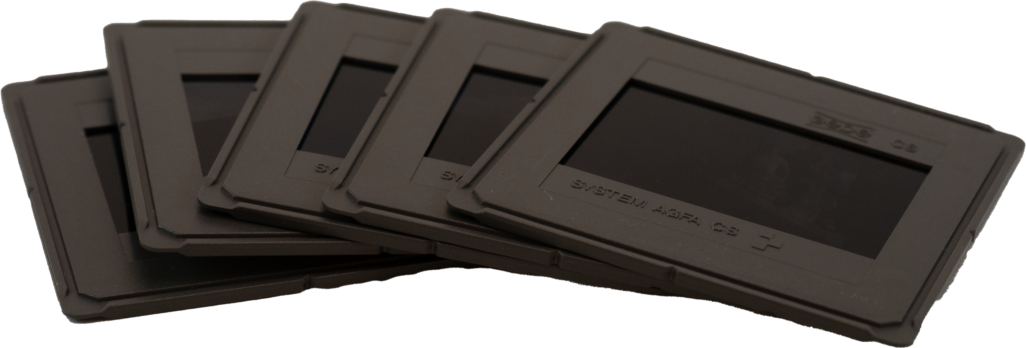
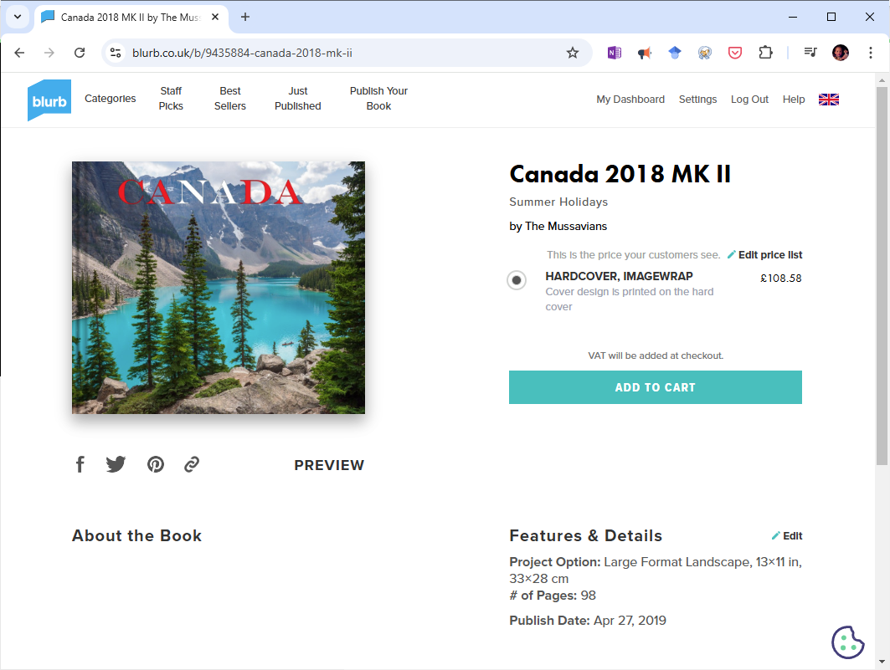
Select and Sort
Design Book
Shoot
Digitise
Publish and Order

Slide 2
Choosing Your Photos

Slide 3
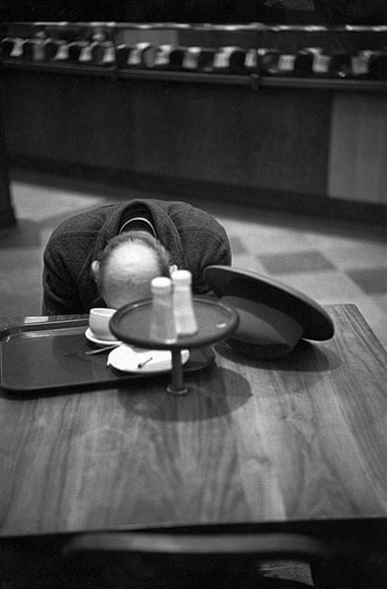
Emotional attachment
FOMO
Large collections
Complex software
Too many choices
Analogue & Digital

Slide 4

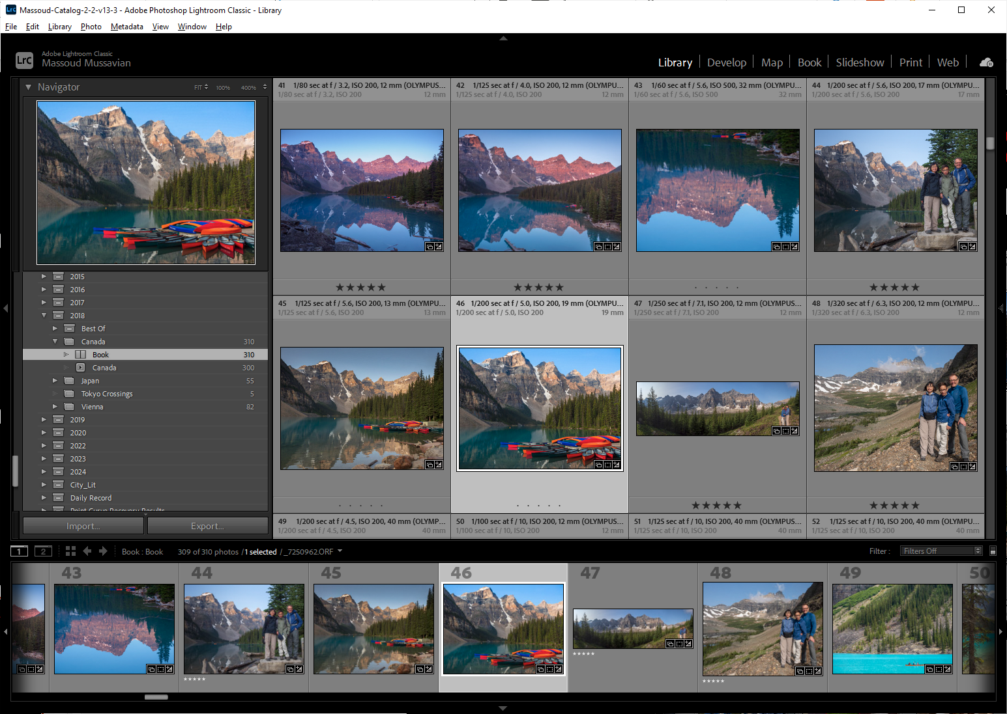
Tips for Selecting and Sorting
Select using:
Flags
Ratings
Colours
Metadata
Keywords
etc.
Create Collection
Custom Ordering

Slide 5
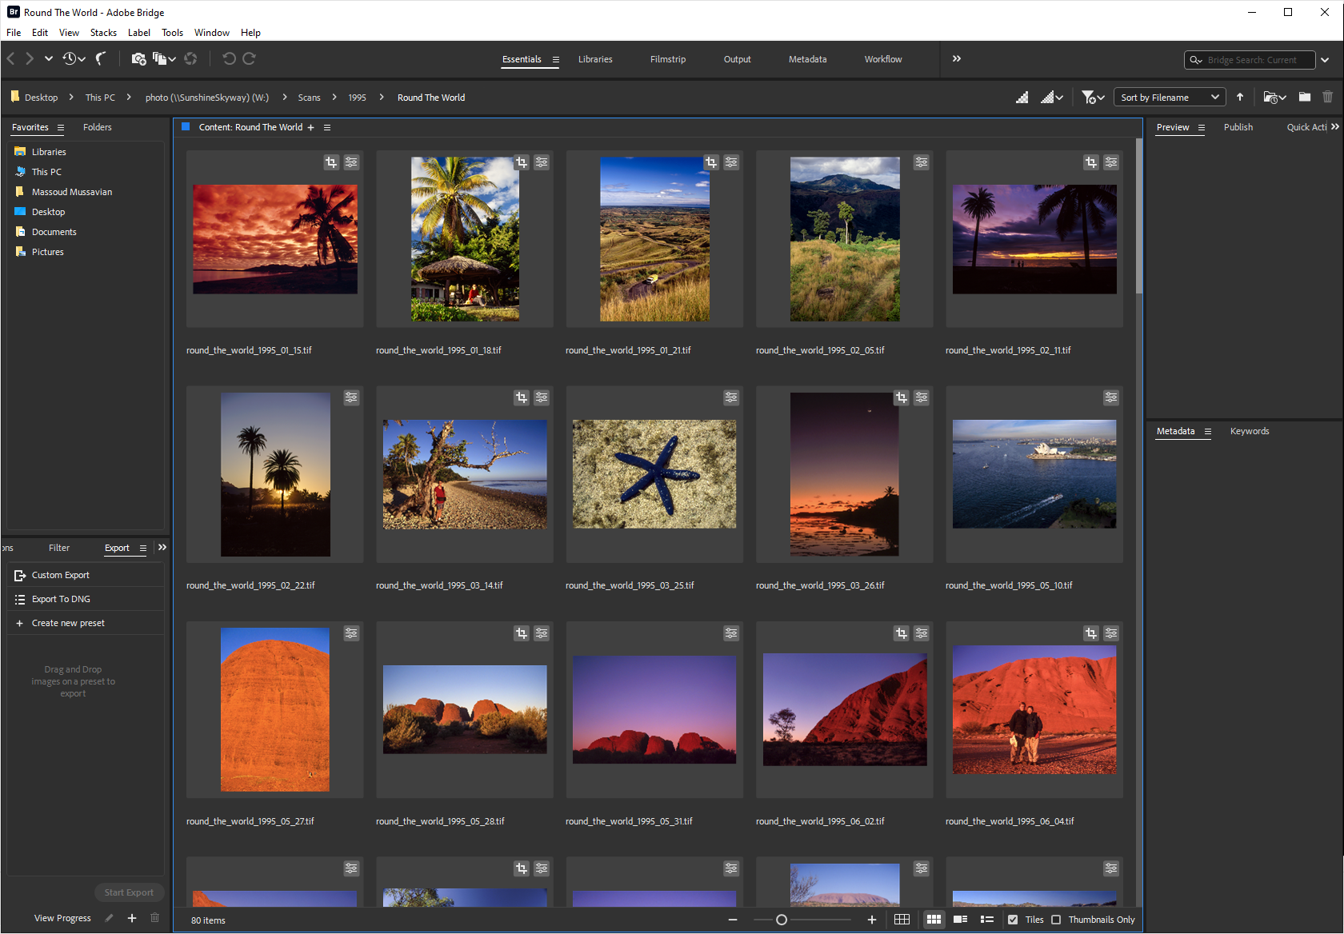
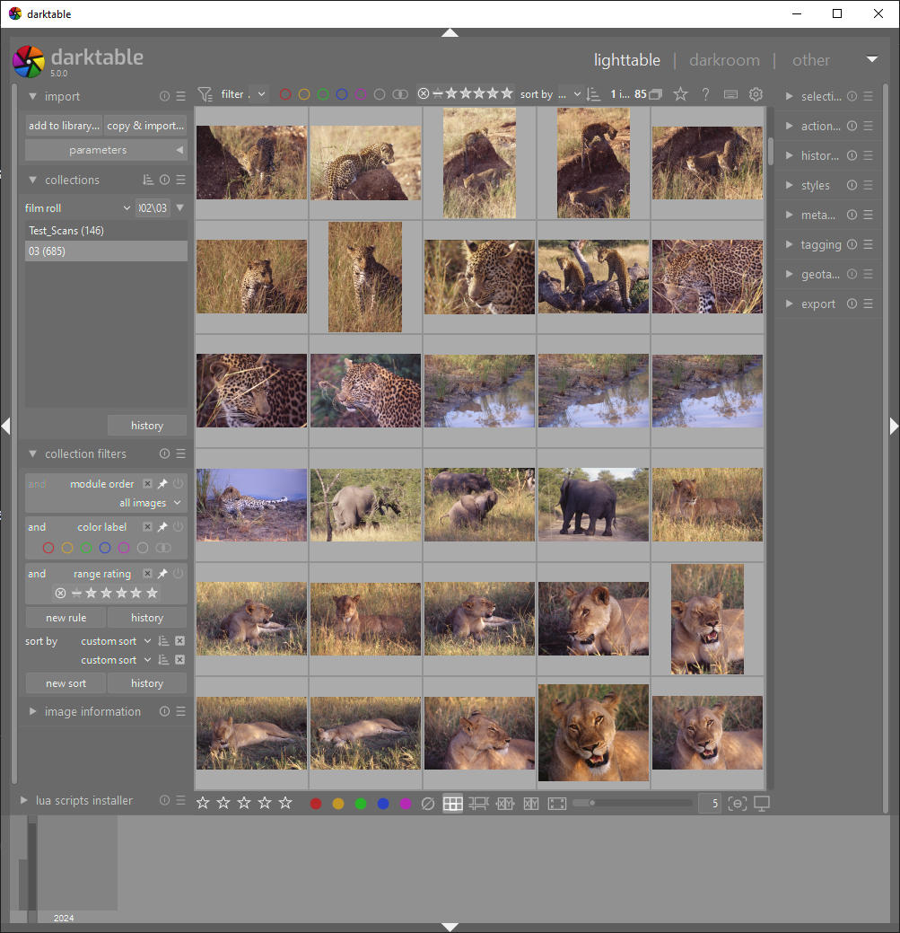
Lightroom Alternatives
Adobe: Bridge
Open Source: darktable
Or others ….

Slide 6
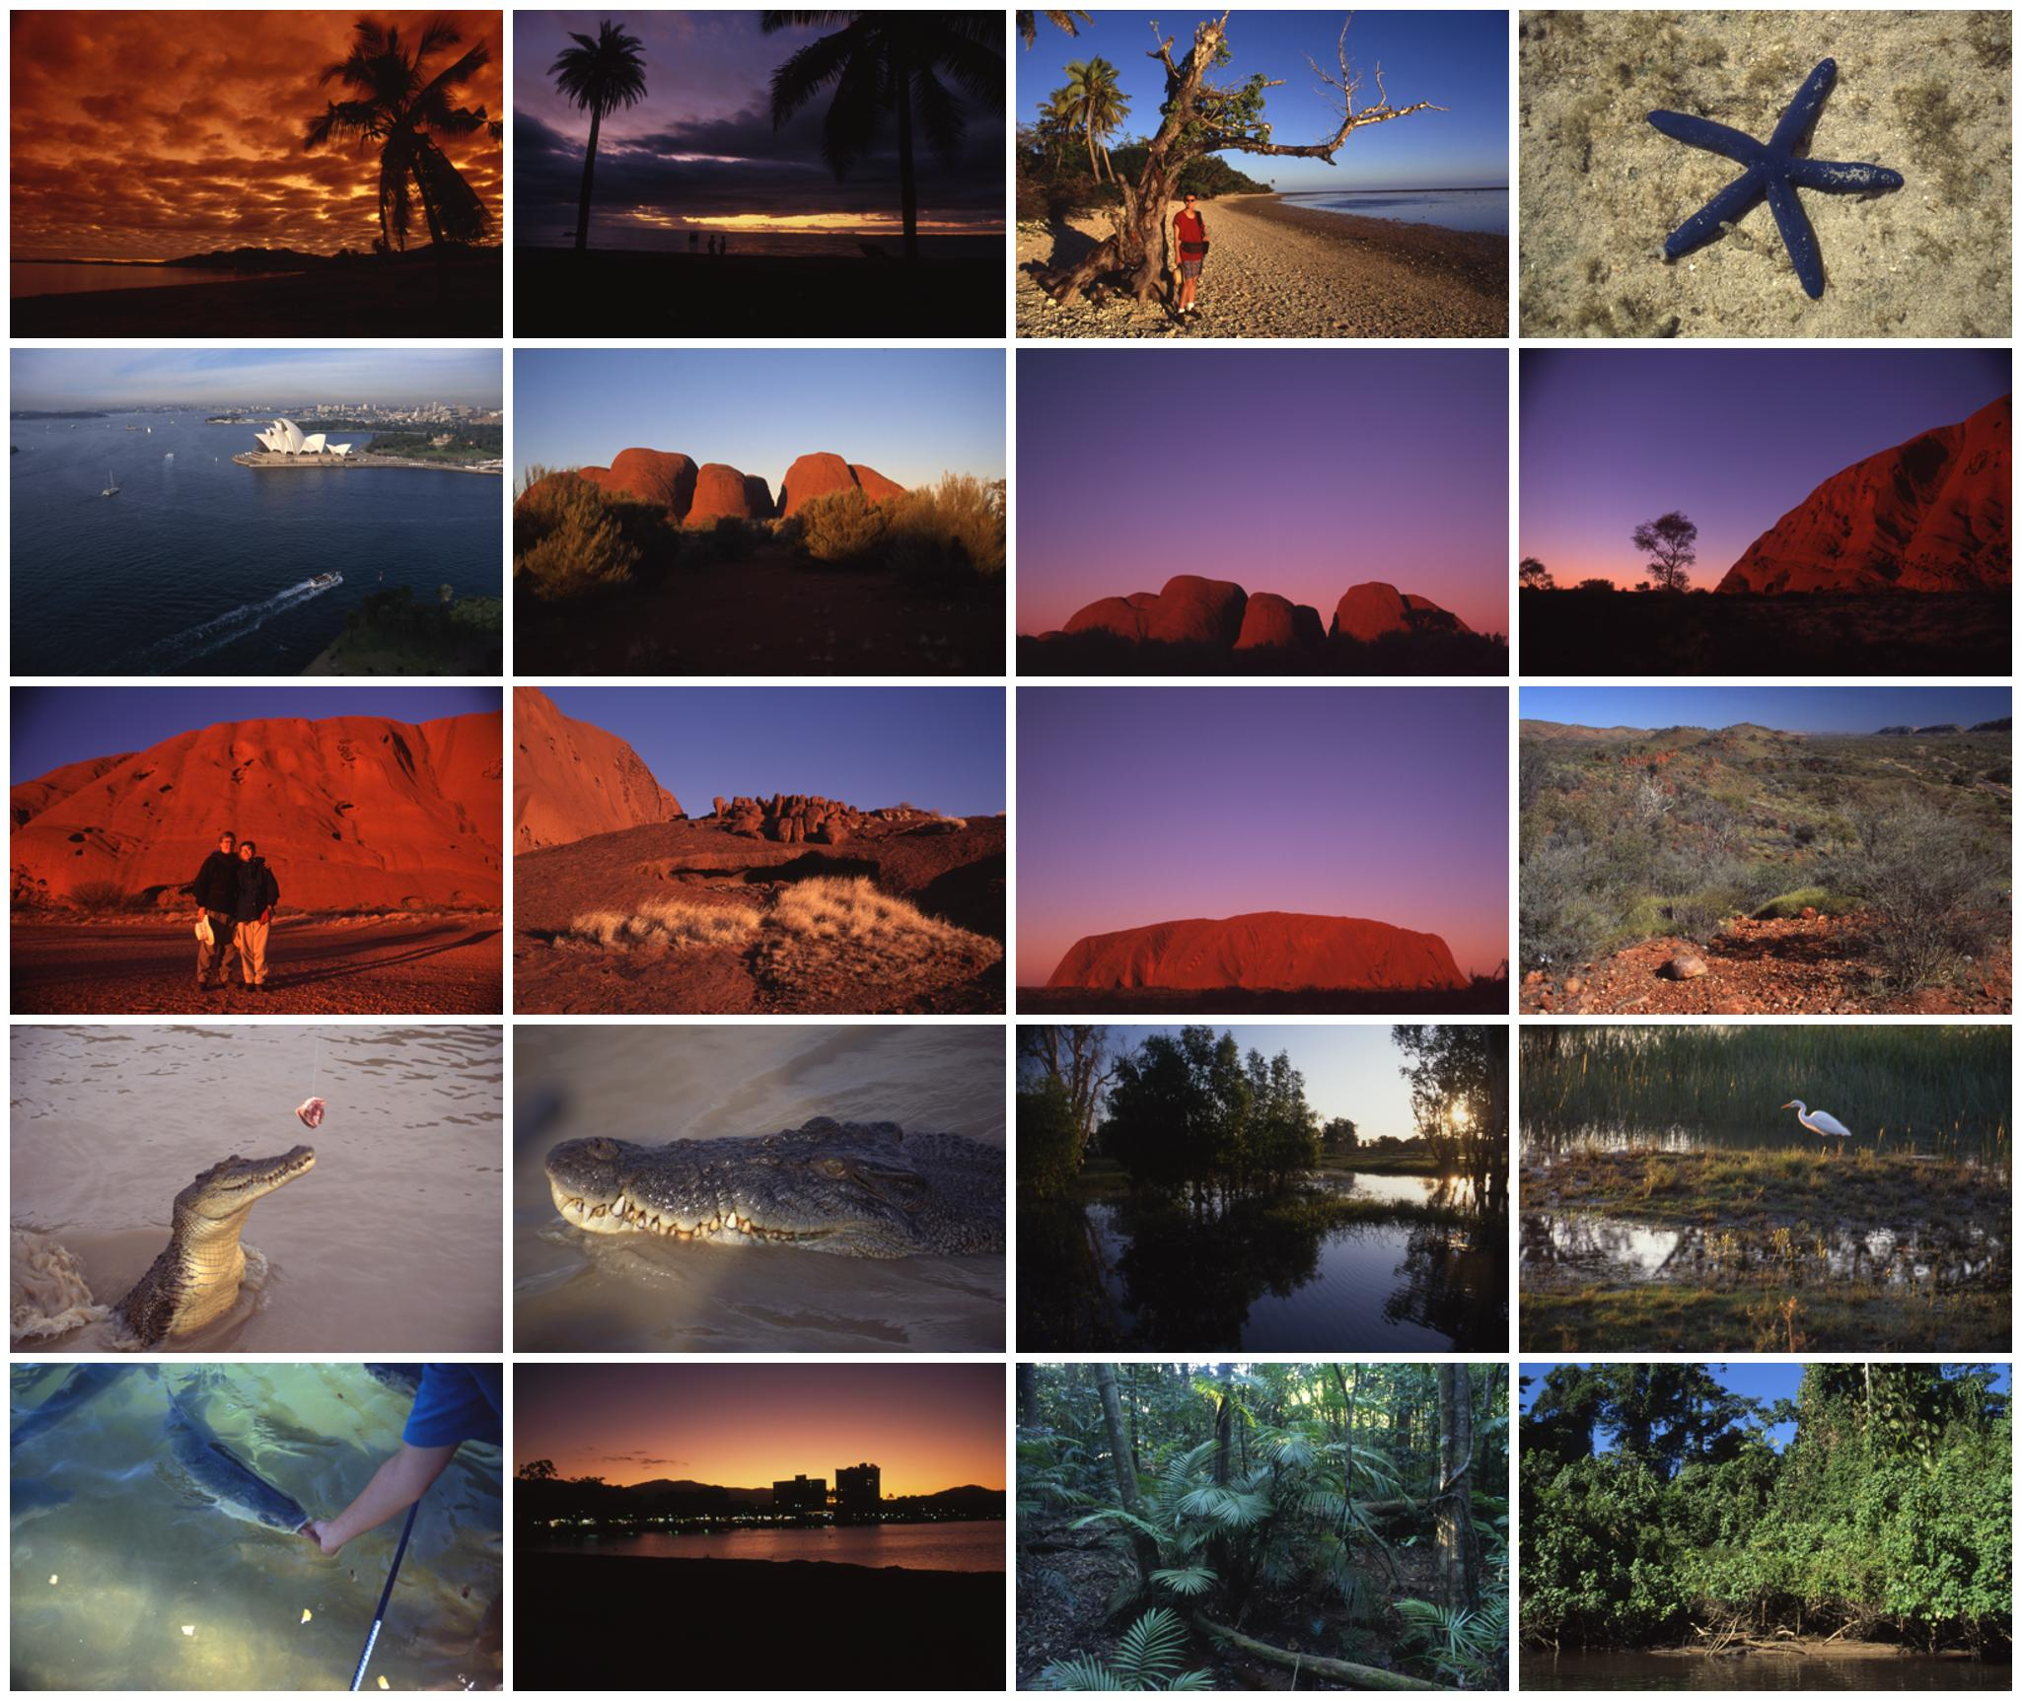
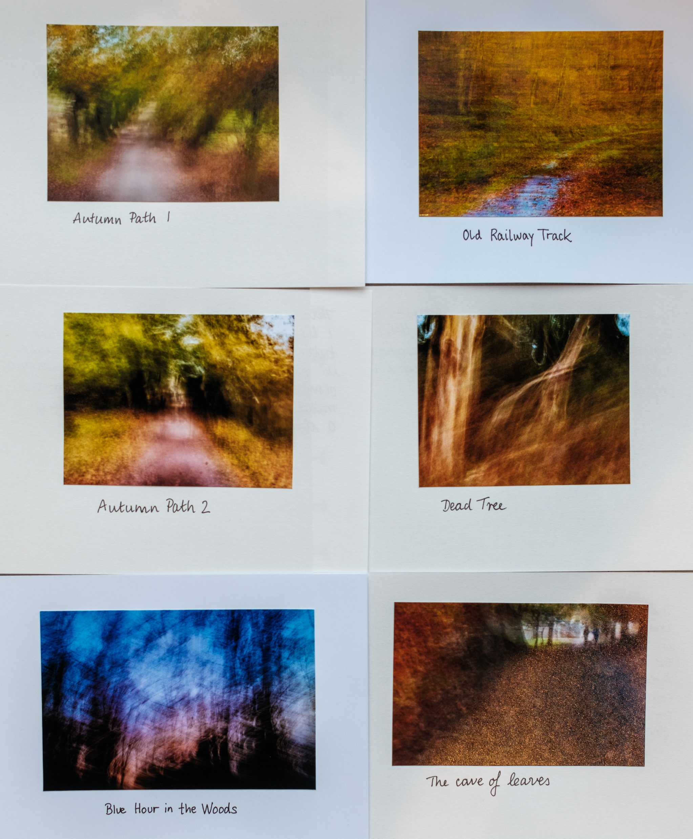
Or Old School …
Contact Sheet
By Hand

Slide 7
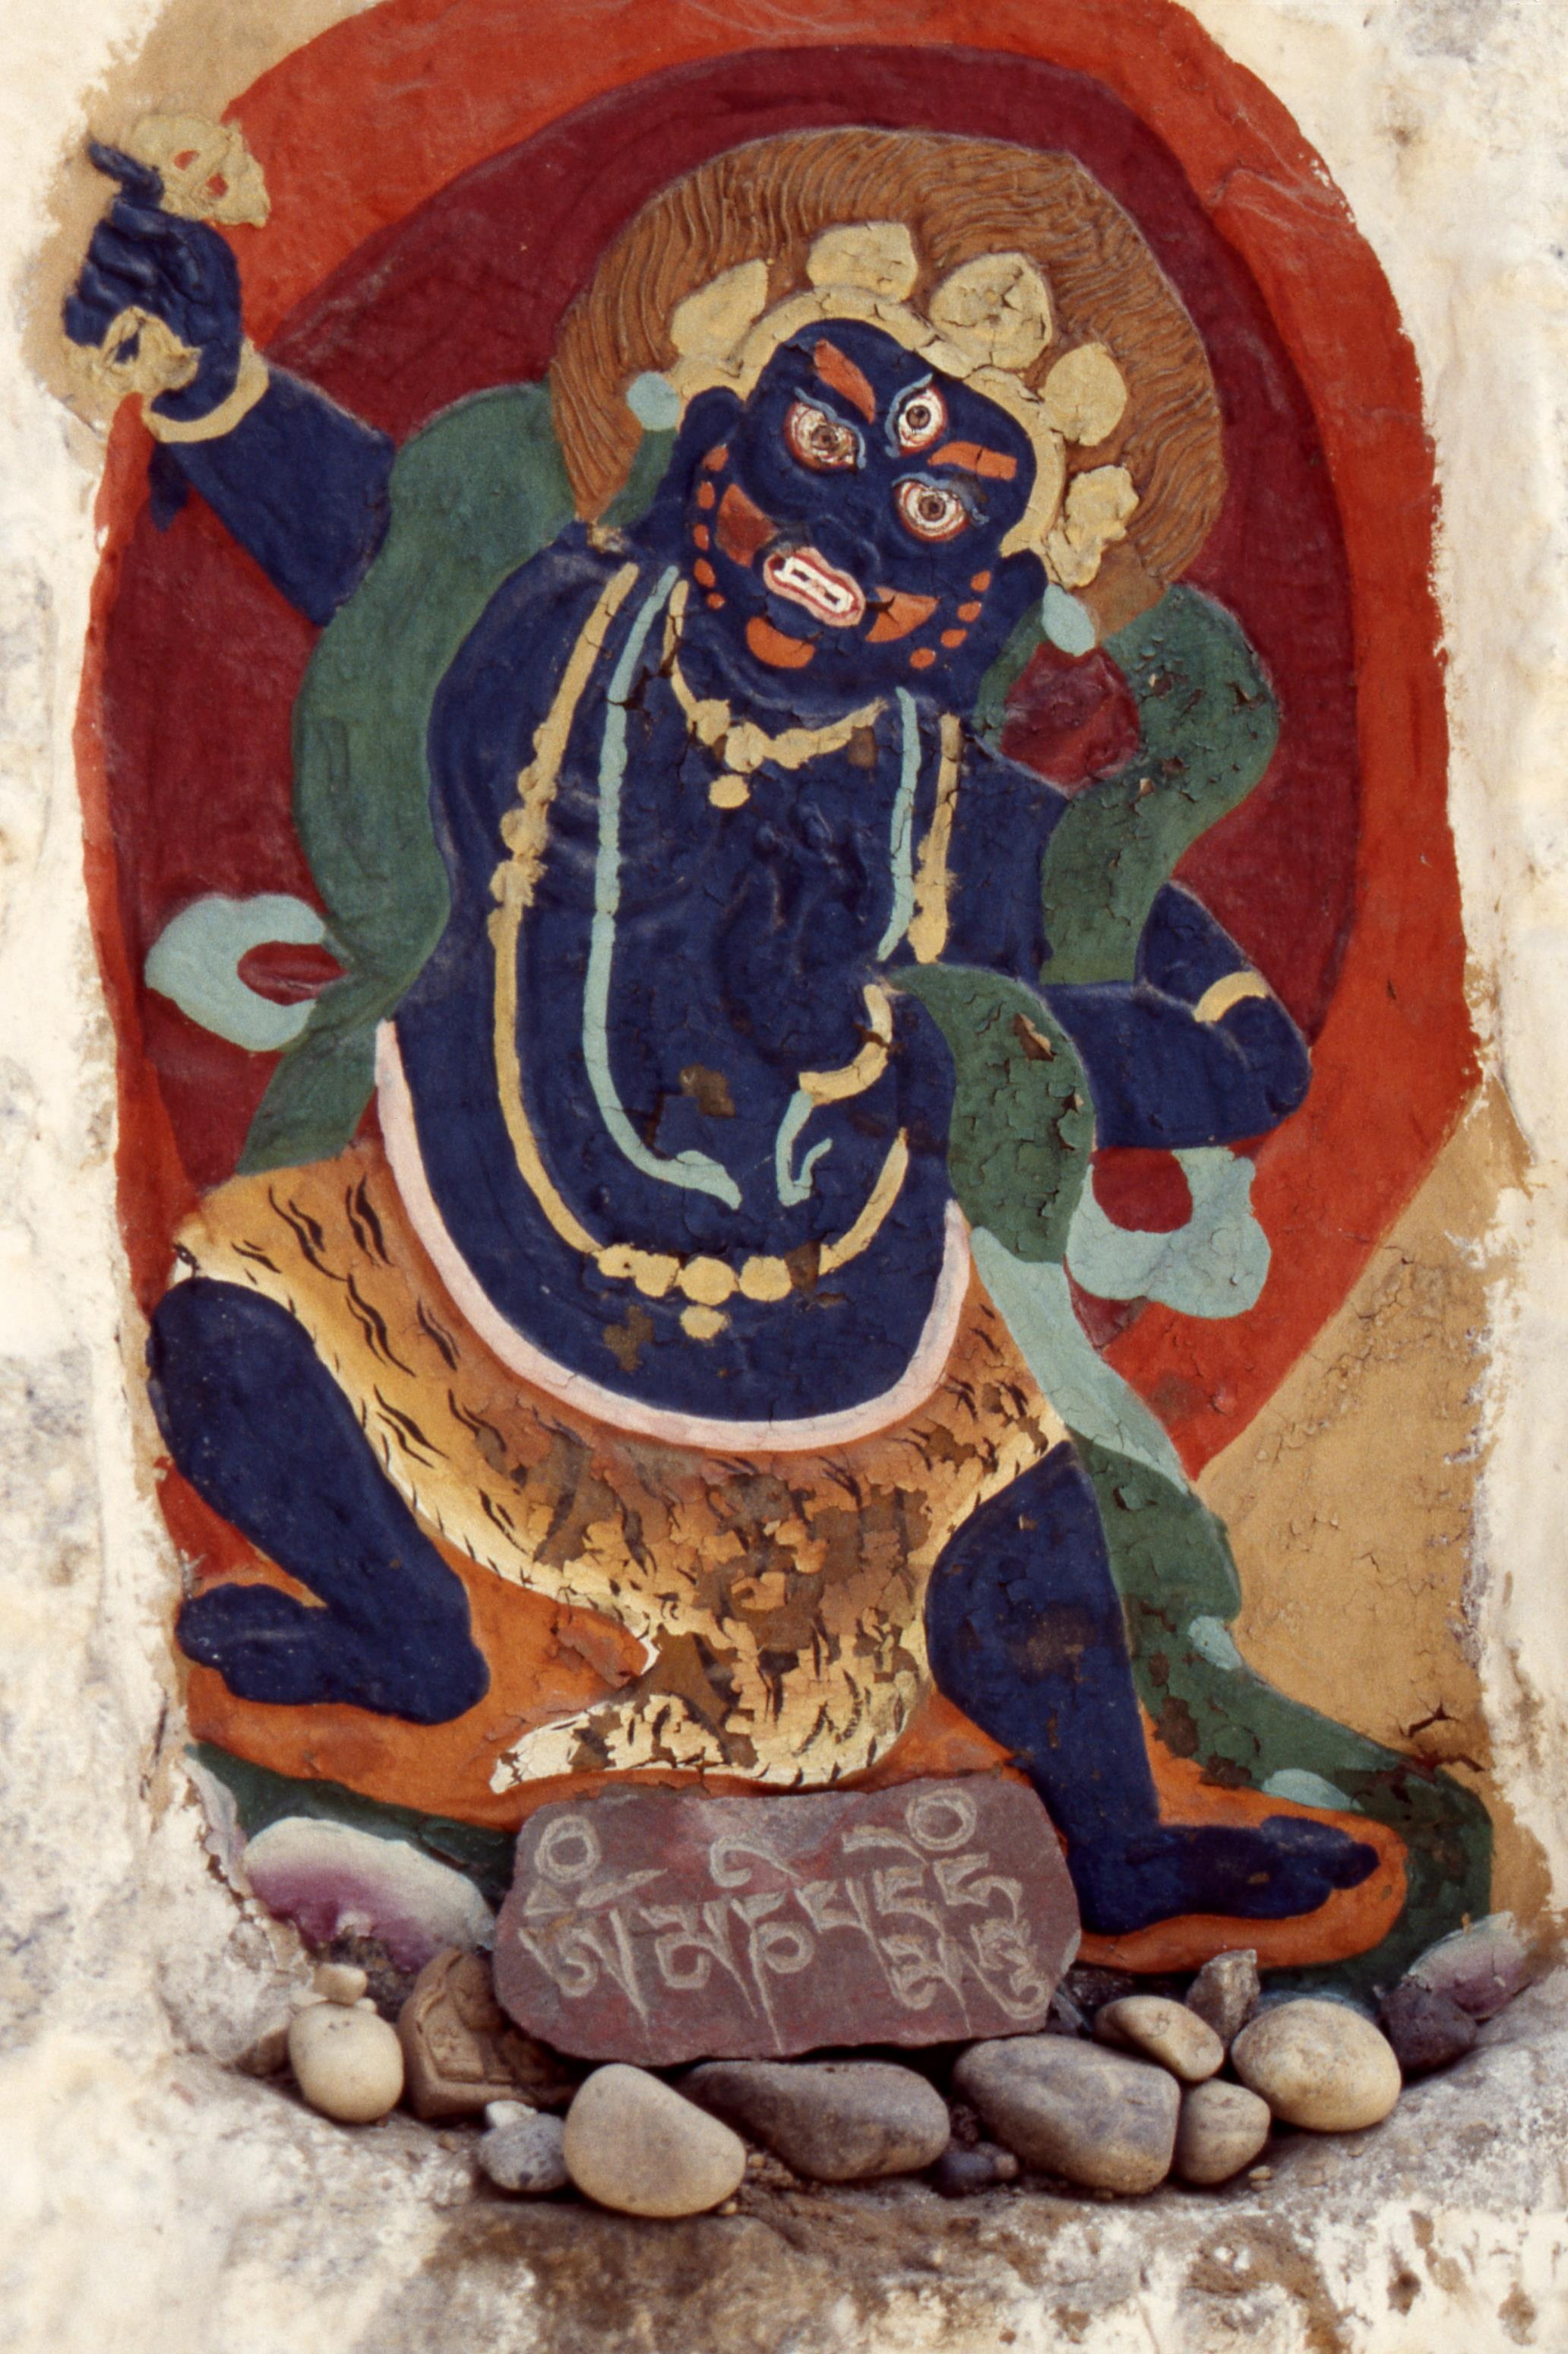
The hardest part is done …

Slide 8
Designing a Photobook

Slide 9
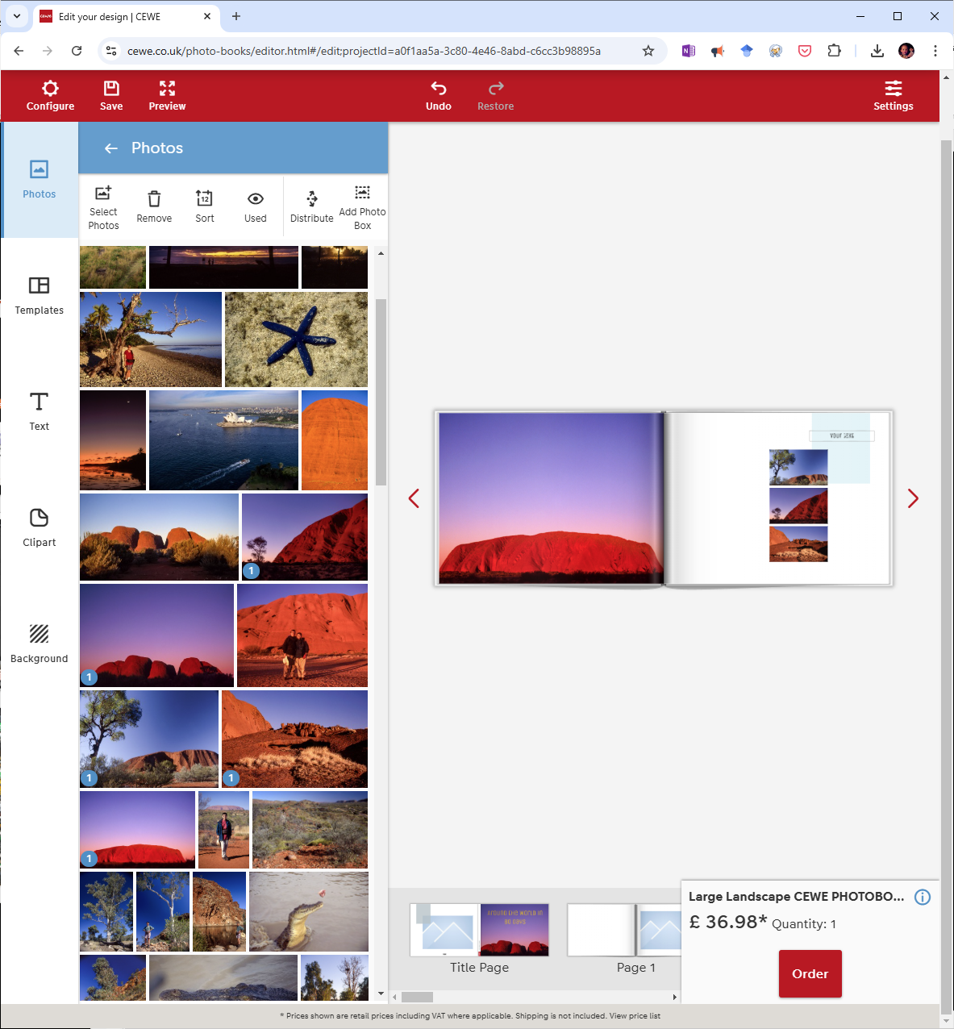
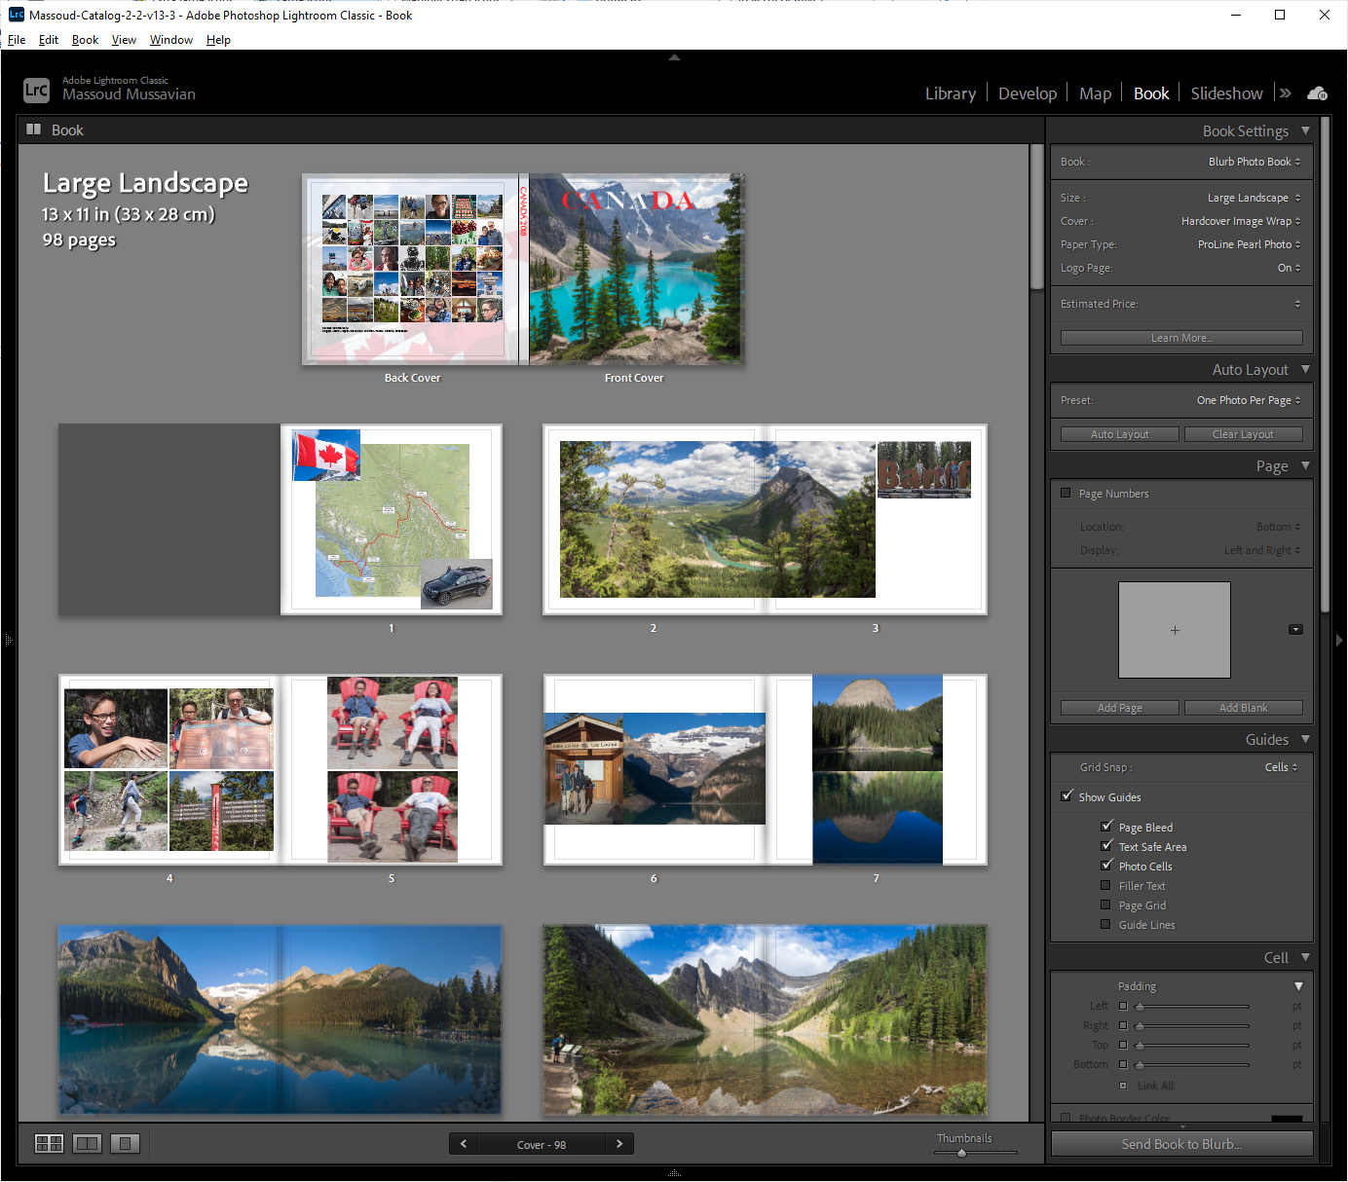
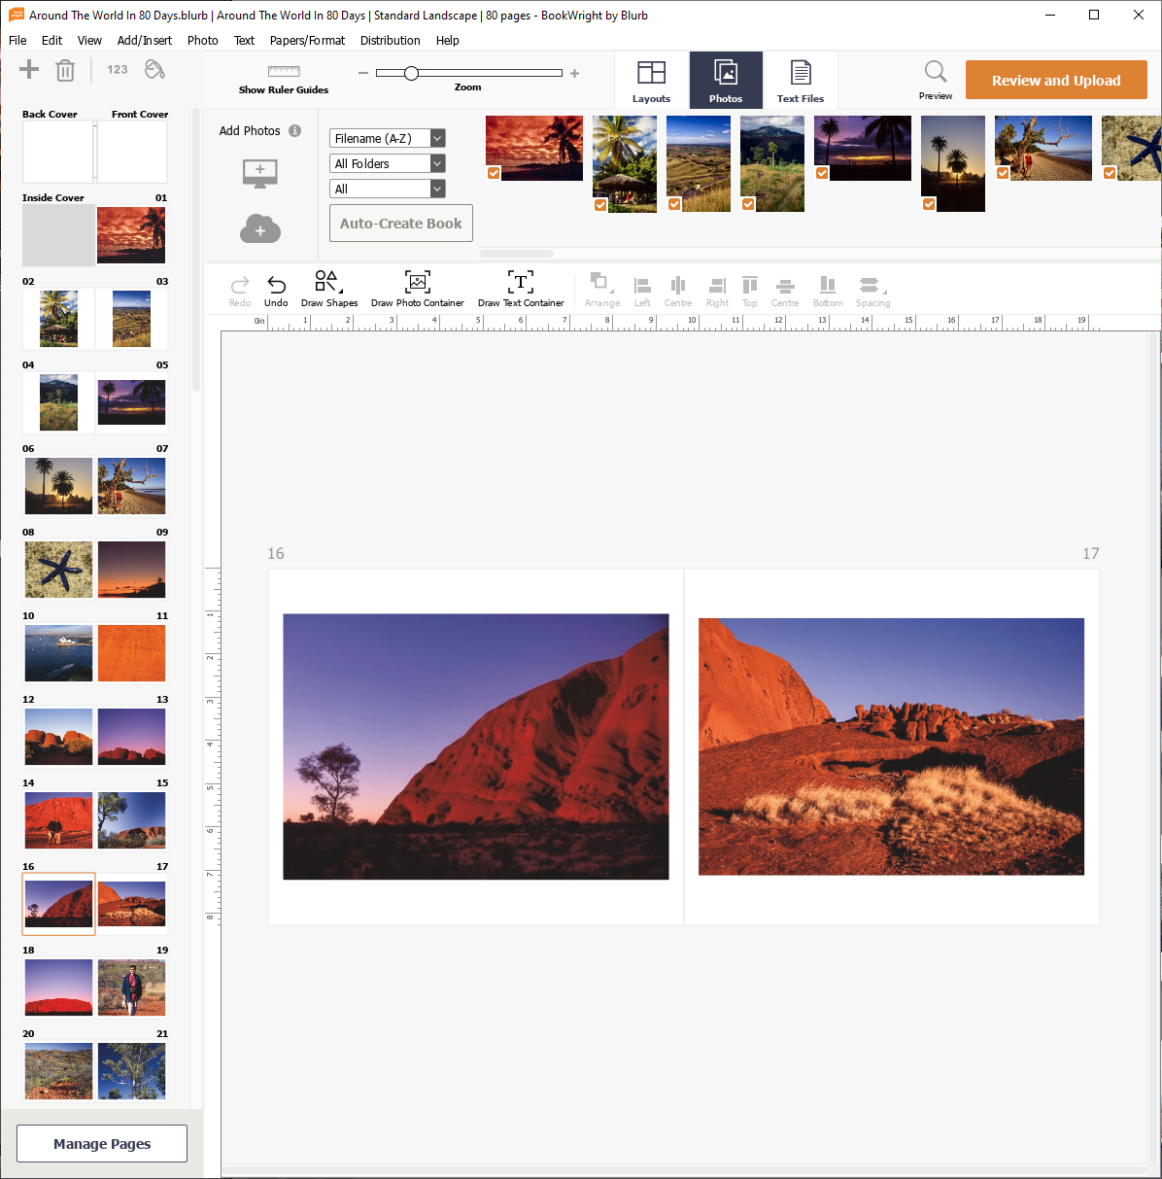
1st Choice: Where?
Online
Lightroom Book Module
Standalone software
Cewe
Mixbook
…
Blurb Bookwright
Saal Design
…

Slide 10


Pros and Cons
Cloud-based Simple Templates | Integrated Workflow Simple Quick | Powerful Lots of controls Versatile
Limited Design Flexibility Separate Workflow Data Security Issues | Limited Design Flexibility Less Creative Control Can Feel Restrictive | Steepest Learning Curve Separate Workflow Can Be Overwhelming
Pros
Cons

Slide 11
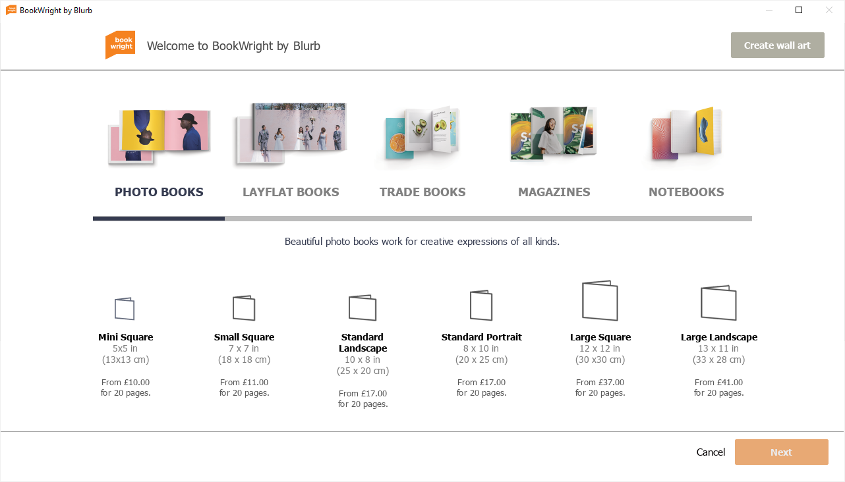
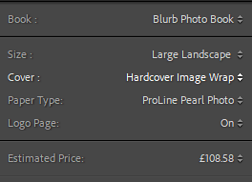
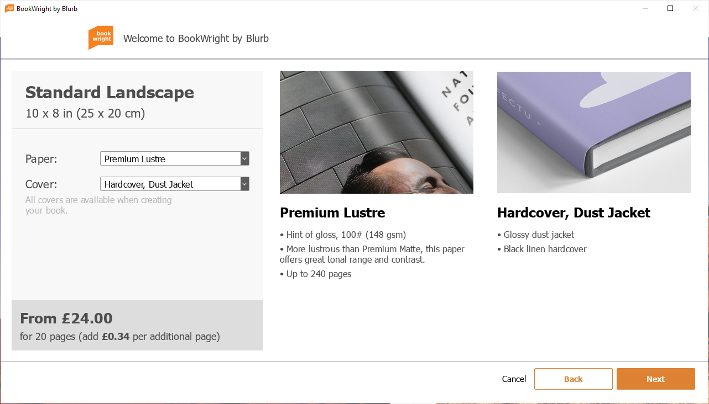
2nd Choice: Size, Cover, Paper and Cost?
Choose your book size
Choose your Cover
Choose your paper
Cost

Slide 12
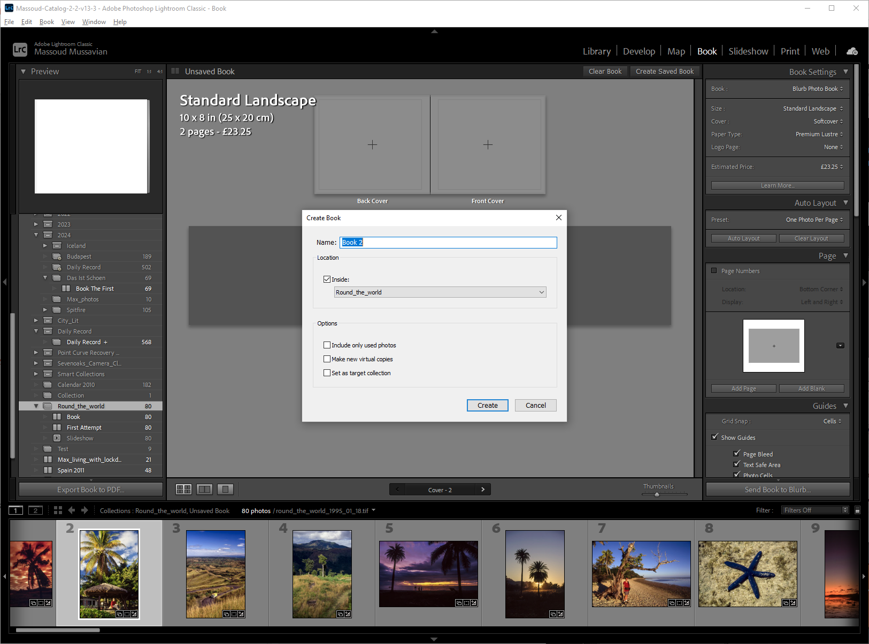
How to get started in LrC
2. Go to book module
4. Clear and create a saved book
3. Make your book choices
5. Name it
6. Unclick
7. Save it
1. Go to your collection

Slide 13
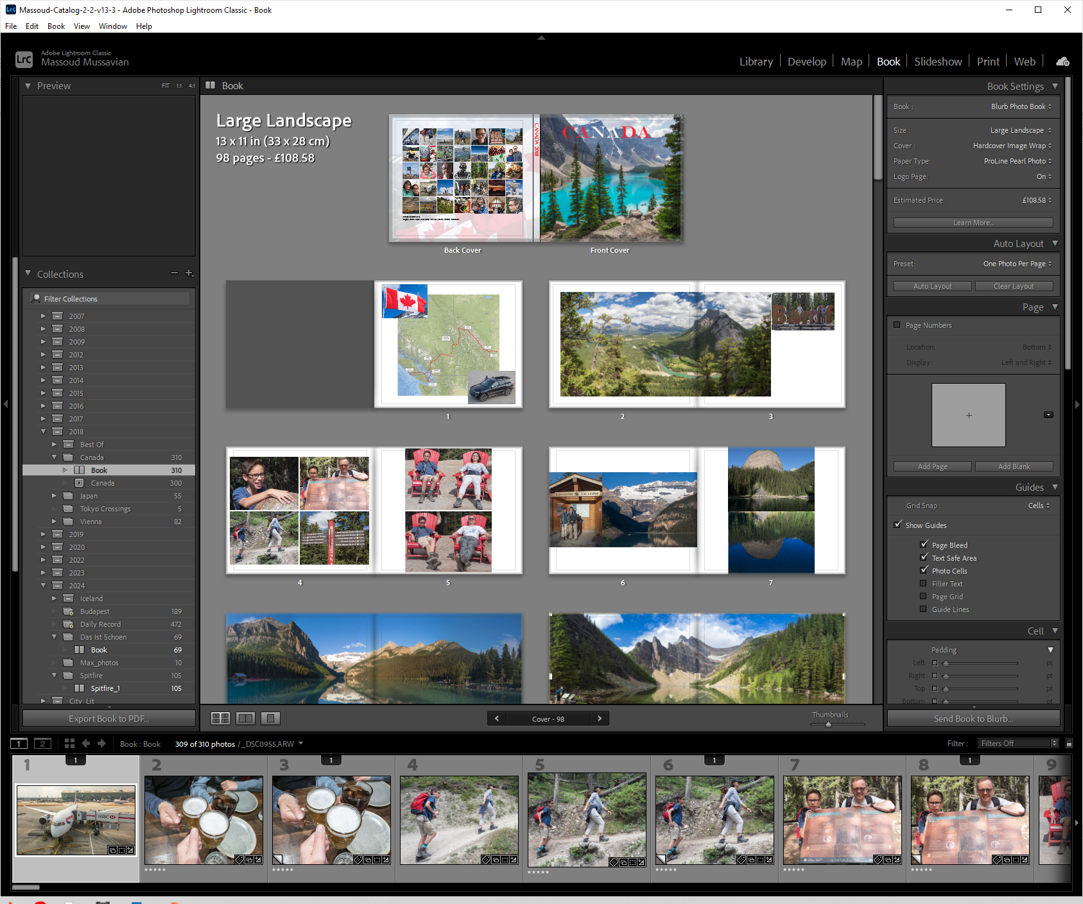

Book Module
Book Settings:
Size
Cover
Paper
Save Book

Slide 14
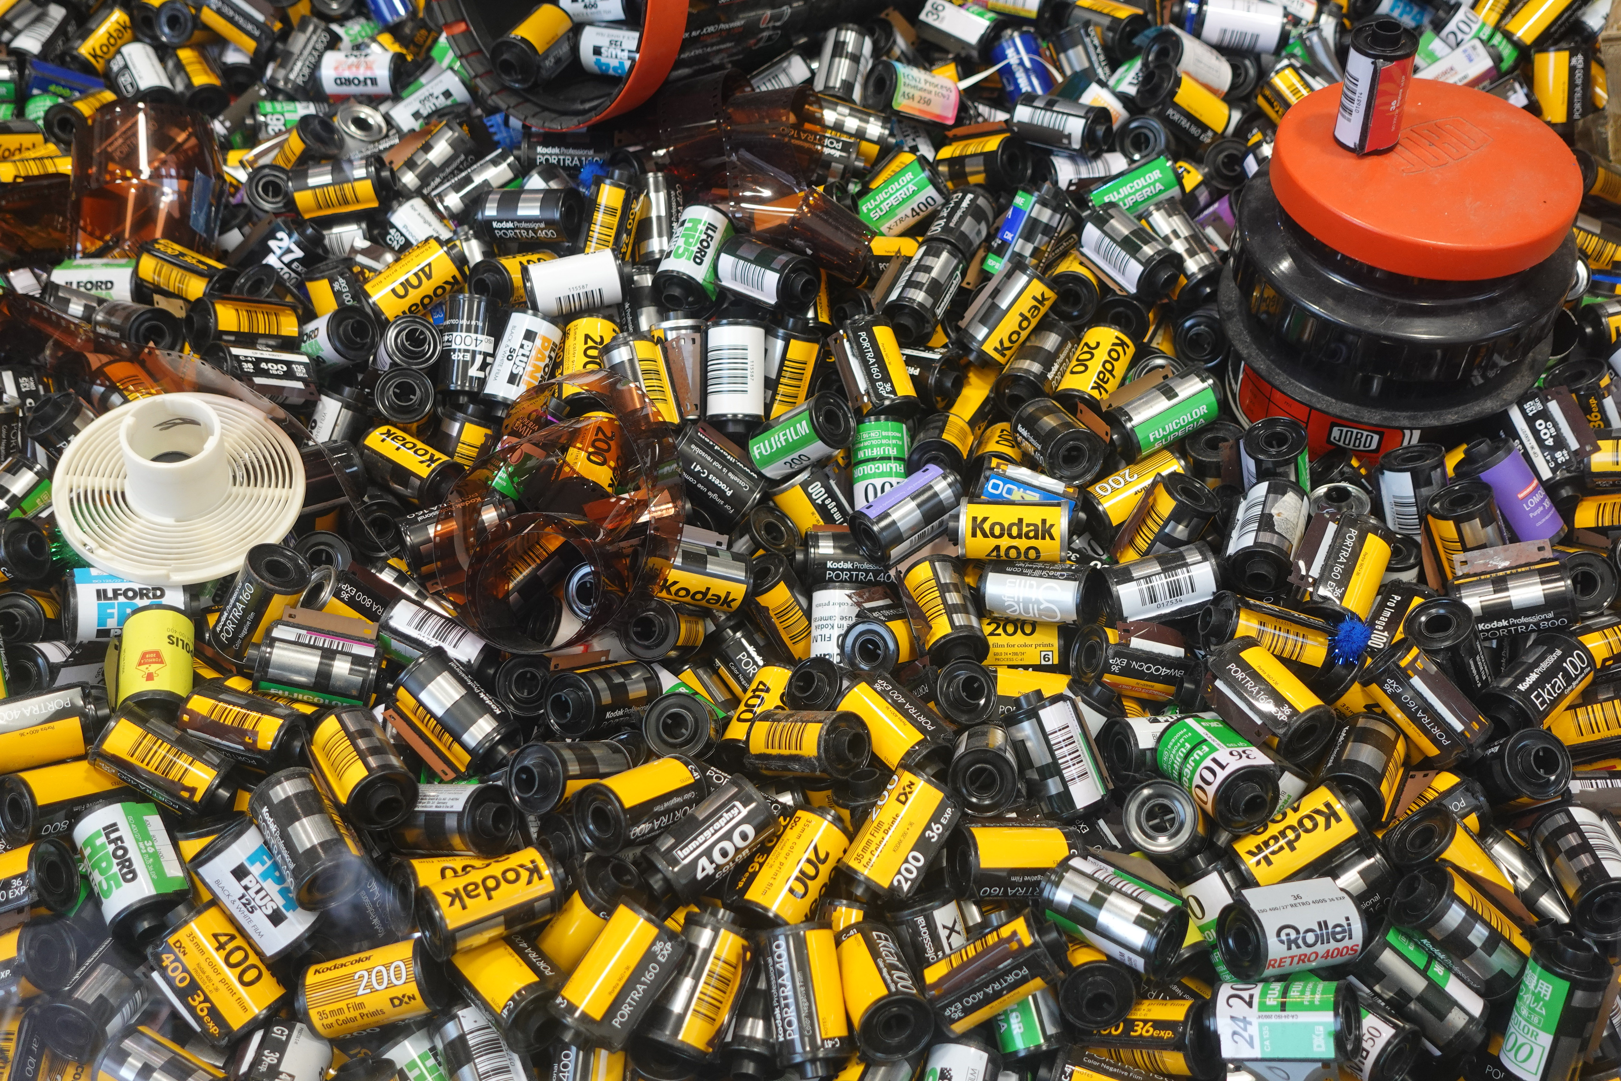
Digitising

Slide 15
Film Scanning or Camera Scanning

Slide 16

Light Sources
Colour of your Light Source
Colour Negative – Cold
B&W Negative – Middle
Colour Slide - Warm

Slide 17
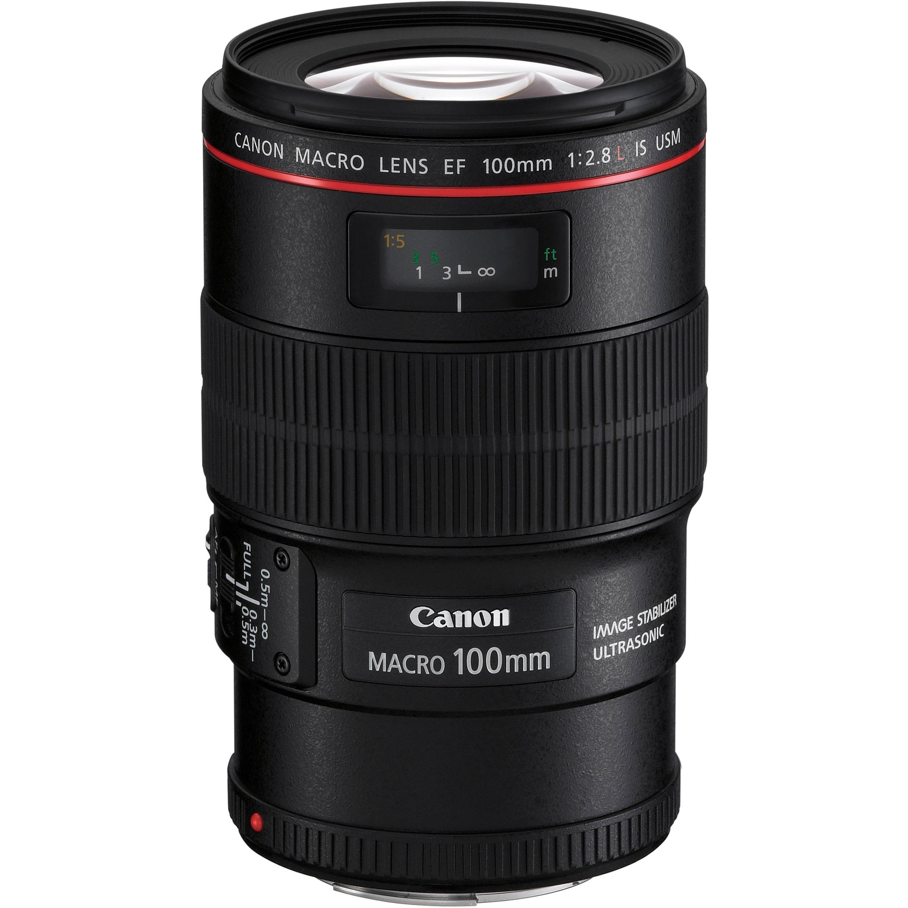
Use a Macro Lens

Slide 18
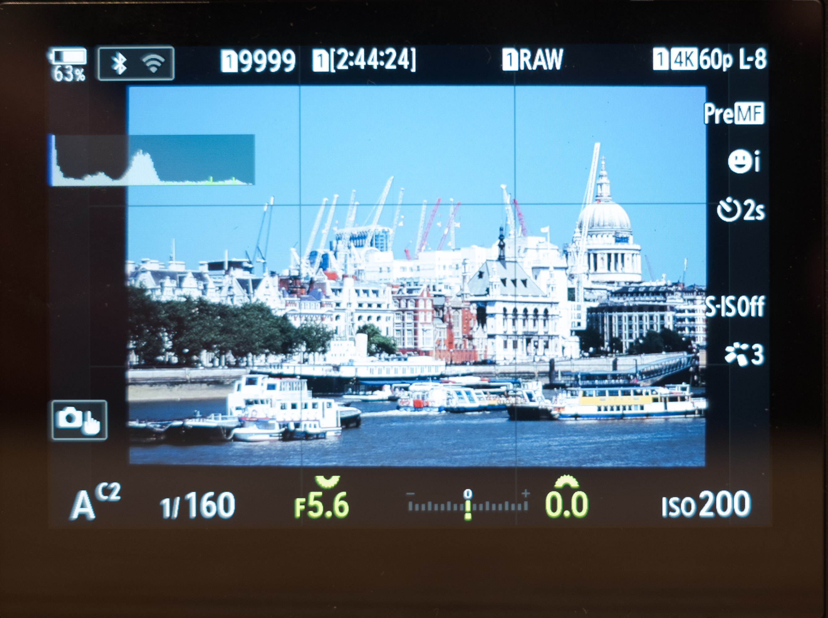
Camera Settings Checklist
Raw Format
Manual Focus
Trigger/Timer
Over/Under-scan
Exposure Comp
Colour Neg: +1
Slides: None
But depends on
Light source
Film type
Aperture Priority
Lens best f stop
Native ISO

Slide 19
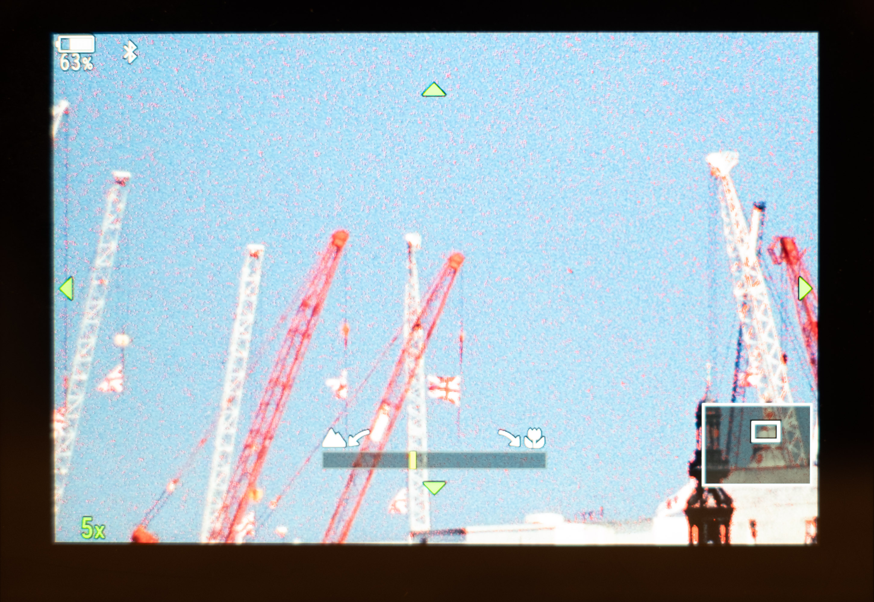
Film Grain Visible
Enable Focus Peaking
Enable Focus Magnification

